Slide 1
TEAM 9
WEEK 0

Slide 2
WEEK 0
DAY 1
Session 2: Movie Time – Spare Part
Session 1: Introduce Our Team Members
In this session, we’ll get to know each other better! Each team member will introduce themselves, sharing a bit about their background, skills, and what they’re excited to learn and contribute.
This will help us build a collaborative and friendly environment as we start this journey together.
We’ll watch the inspiring movie Spare Parts. This film is based on a true story about four Hispanic high school students who form a robotics club with no experience, only $800, and used car parts — and go on to compete against the country’s top colleges, including MIT. It’s a powerful story about teamwork, innovation, and determination. The movie shows how creativity and perseverance can overcome limited resources and tough challenges. It’s a perfect motivation as we start working together on our projects

Slide 3

WEEK 0
Session 2: Movie Time – Spare Part
We’ll watch the inspiring movie Spare Parts. This film is based on a true story about four Hispanic high school students who form a robotics club with no experience, only $800, and used car parts — and go on to compete against the country’s top colleges, including MIT. It’s a powerful story about teamwork, innovation, and determination. The movie shows how creativity and perseverance can overcome limited resources and tough challenges. It’s a perfect motivation as we start working together on our projects

Slide 4
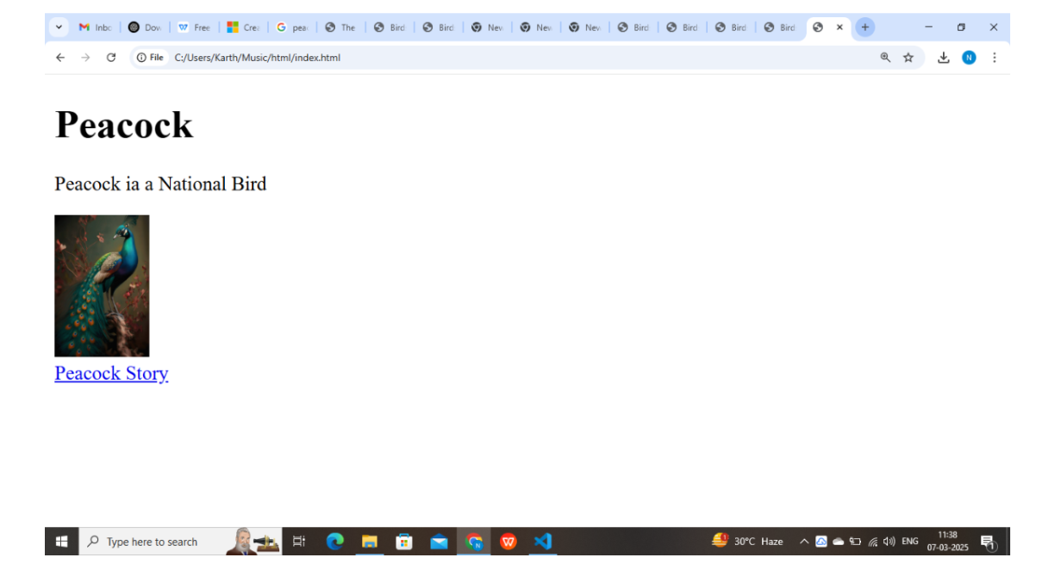
DAY 2
Session 3: HTML Portfolio Creation
In this hands-on session, we’ll dive into HTML and start building our personal portfolios. We’ll cover the basics of HTML structure and learn how to create different sections like About Me, Projects, and Contact Information.
We’ll also start adding simple CSS to style the portfolio. By the end of this session, everyone will have a foundation for their own portfolio website — a key step in showcasing your skills and growth throughout this journey.

Slide 5
DAY 2
Session 3: HTML Portfolio Creation
In this hands-on session, we’ll dive into HTML and start building our personal portfolios. We’ll cover the basics of HTML structure and learn how to create different sections like About Me, Projects, and Contact Information.
We’ll also start adding simple CSS to style the portfolio. By the end of this session, everyone will have a foundation for their own portfolio website — a key step in showcasing your skills and growth throughout this journey.

Slide 6
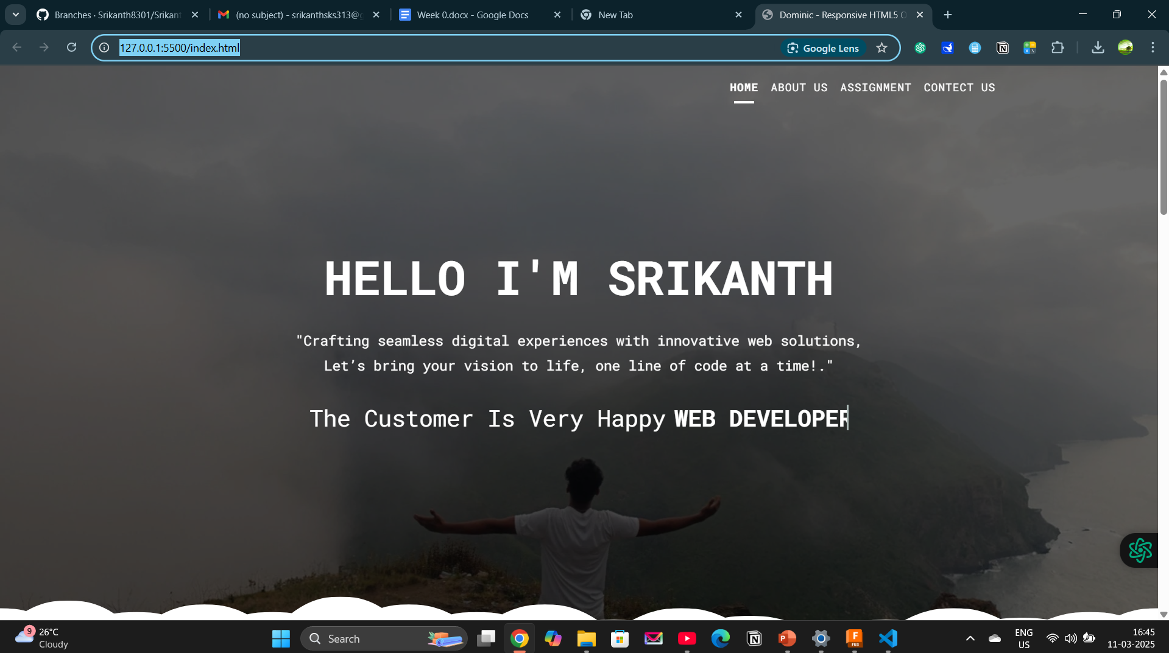
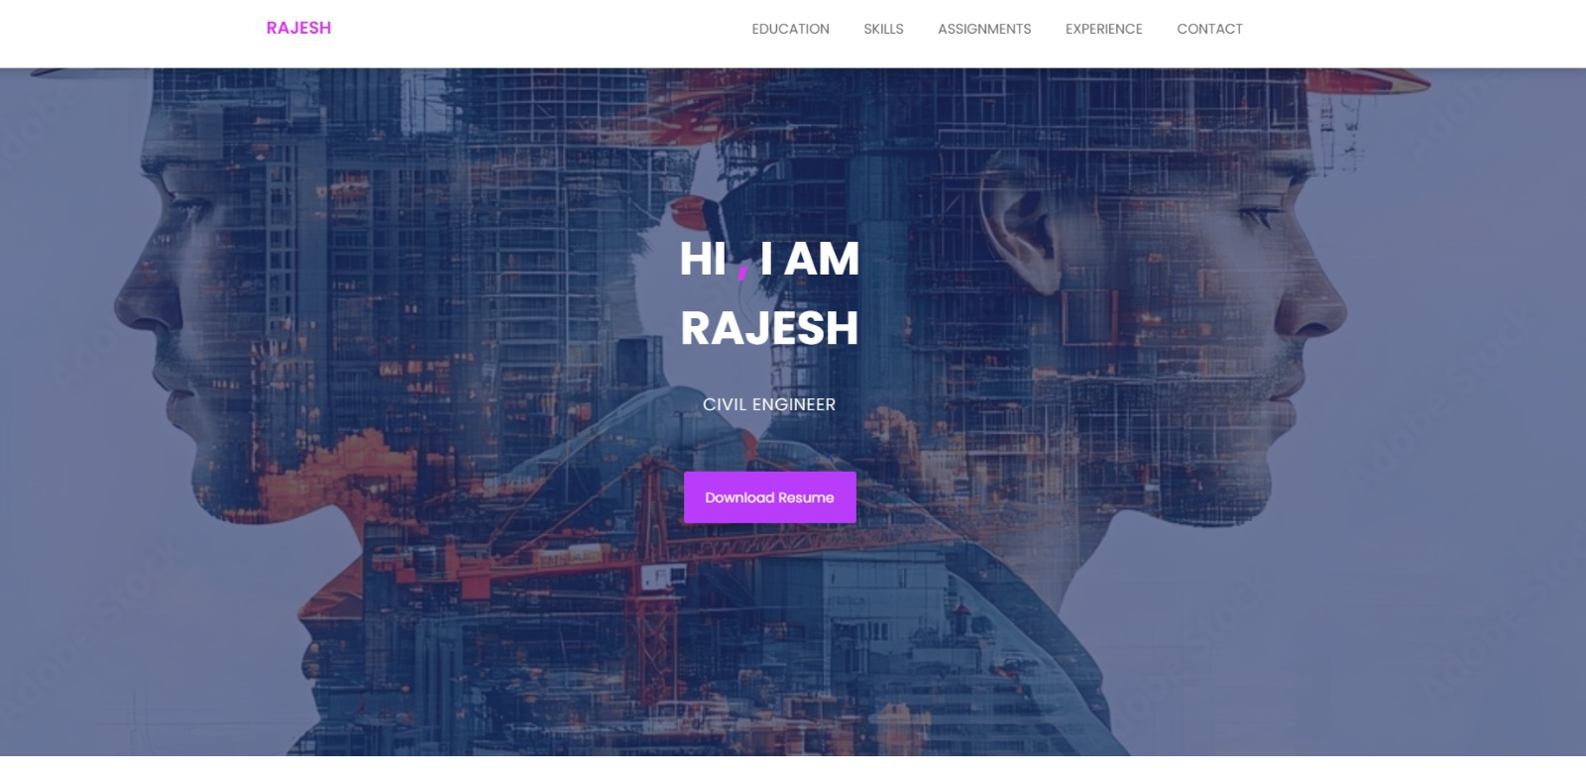
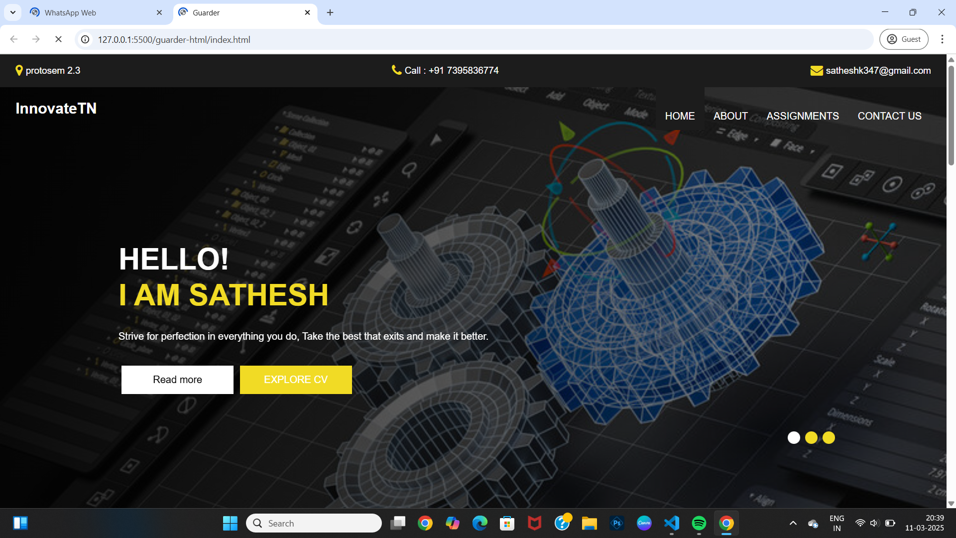
DAY 3
Continue to Personal Portfolio Creation
In this hands-on session, we’ll dive into create individual portfolios for every team member to highlight their work and strength.

Slide 7
WEEK 1

Slide 8
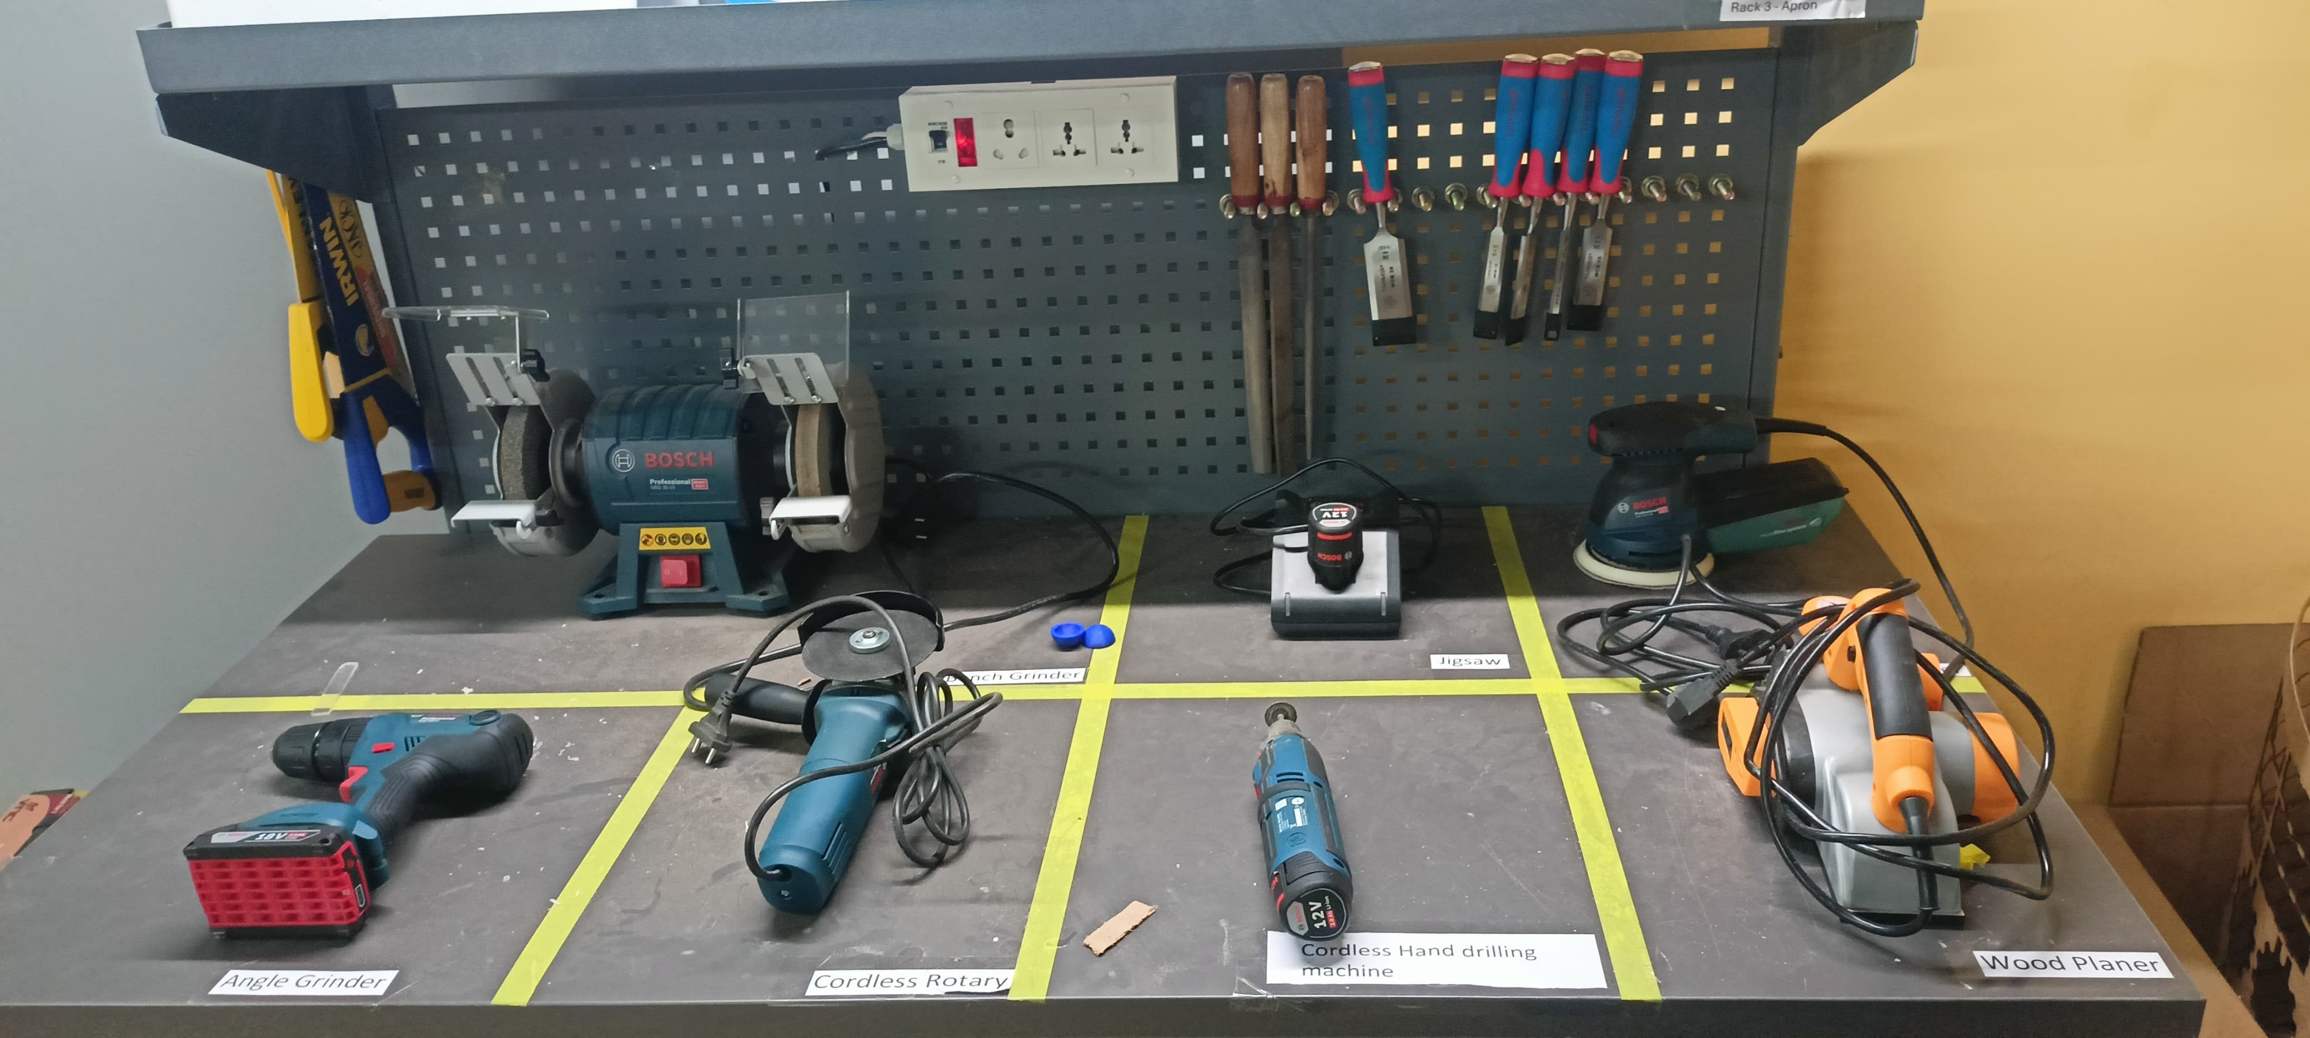
Session 1: Understanding 5S and Organizing the Forge Lab
In this session, we focused on understanding and implementing the 5S methodology, a widely used system for workplace organization and efficiency. Originating from Japanese manufacturing practices, the 5S principles help create a clean, efficient, and safe working environment. These principles are:
Sort
Set In Order
Shine
Standardize
Sustain

Slide 9
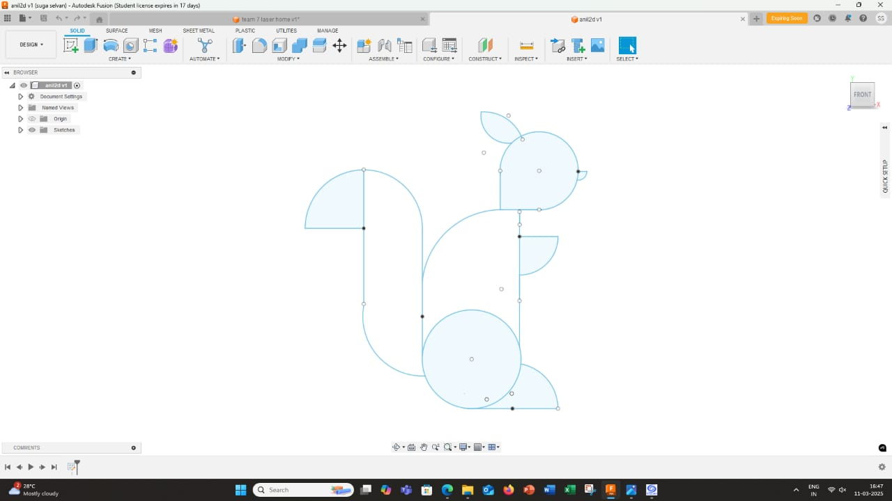
Session 2: Introduction to Fusion 360
In the next session, we will dive into Fusion 360, an industry-standard 3D CAD (Computer-Aided Design), CAM (Computer-Aided Manufacturing), and CAE (Computer-Aided Engineering) software developed by Autodesk. Fusion 360 is a powerful and versatile tool used for product design, mechanical engineering, and digital fabrication.

Slide 10
Session 3: Learning FlatFab and Creating Designs
In the third session, we will explore FlatFab, an innovative design tool focused on creating 3D objects from 2D flat patterns. FlatFab simplifies the process of designing for laser cutting, CNC machining, and other fabrication techniques that rely on flat materials.

Slide 11
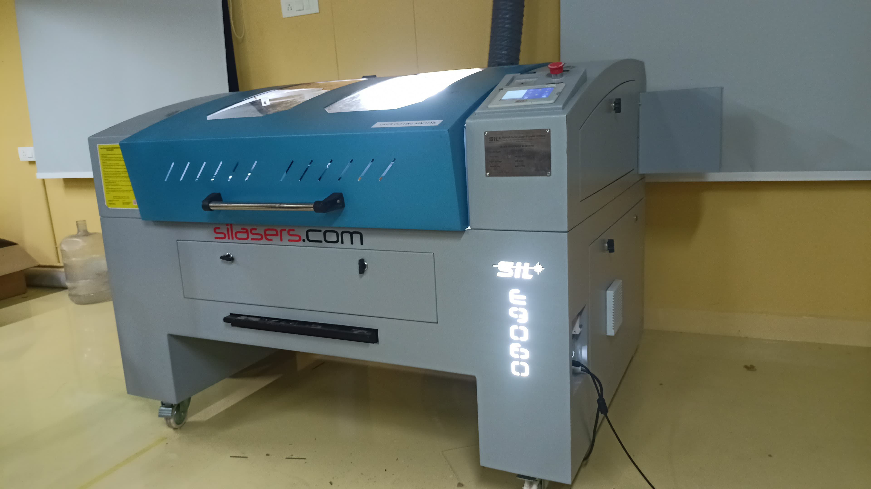
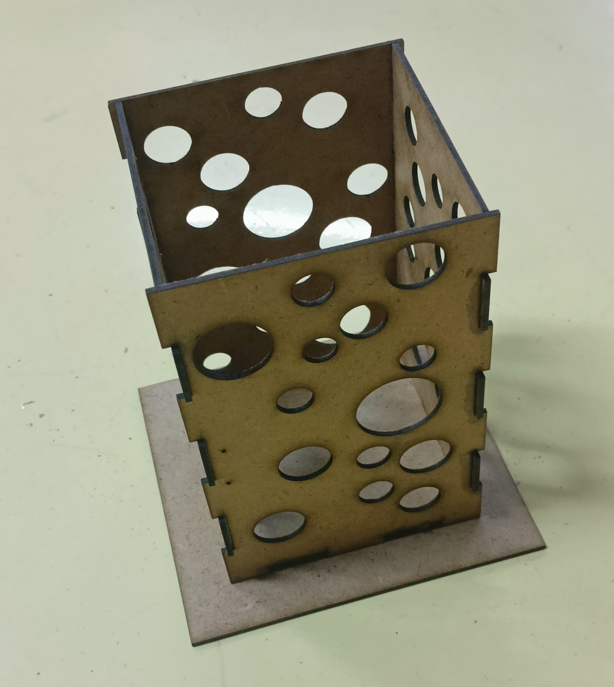
Session 3: Learning Laser Cutting
During this session, we had the opportunity to gain hands-on experience with laser cutting technology. The session provided a comprehensive understanding of how laser cutting machines operate, including their key components, functions, and the different types of materials that can be processed using this technique.

